Slide 1

Conquer your fears
Notes:
Embrace failing… Rehearsal your fails…

Slide 2
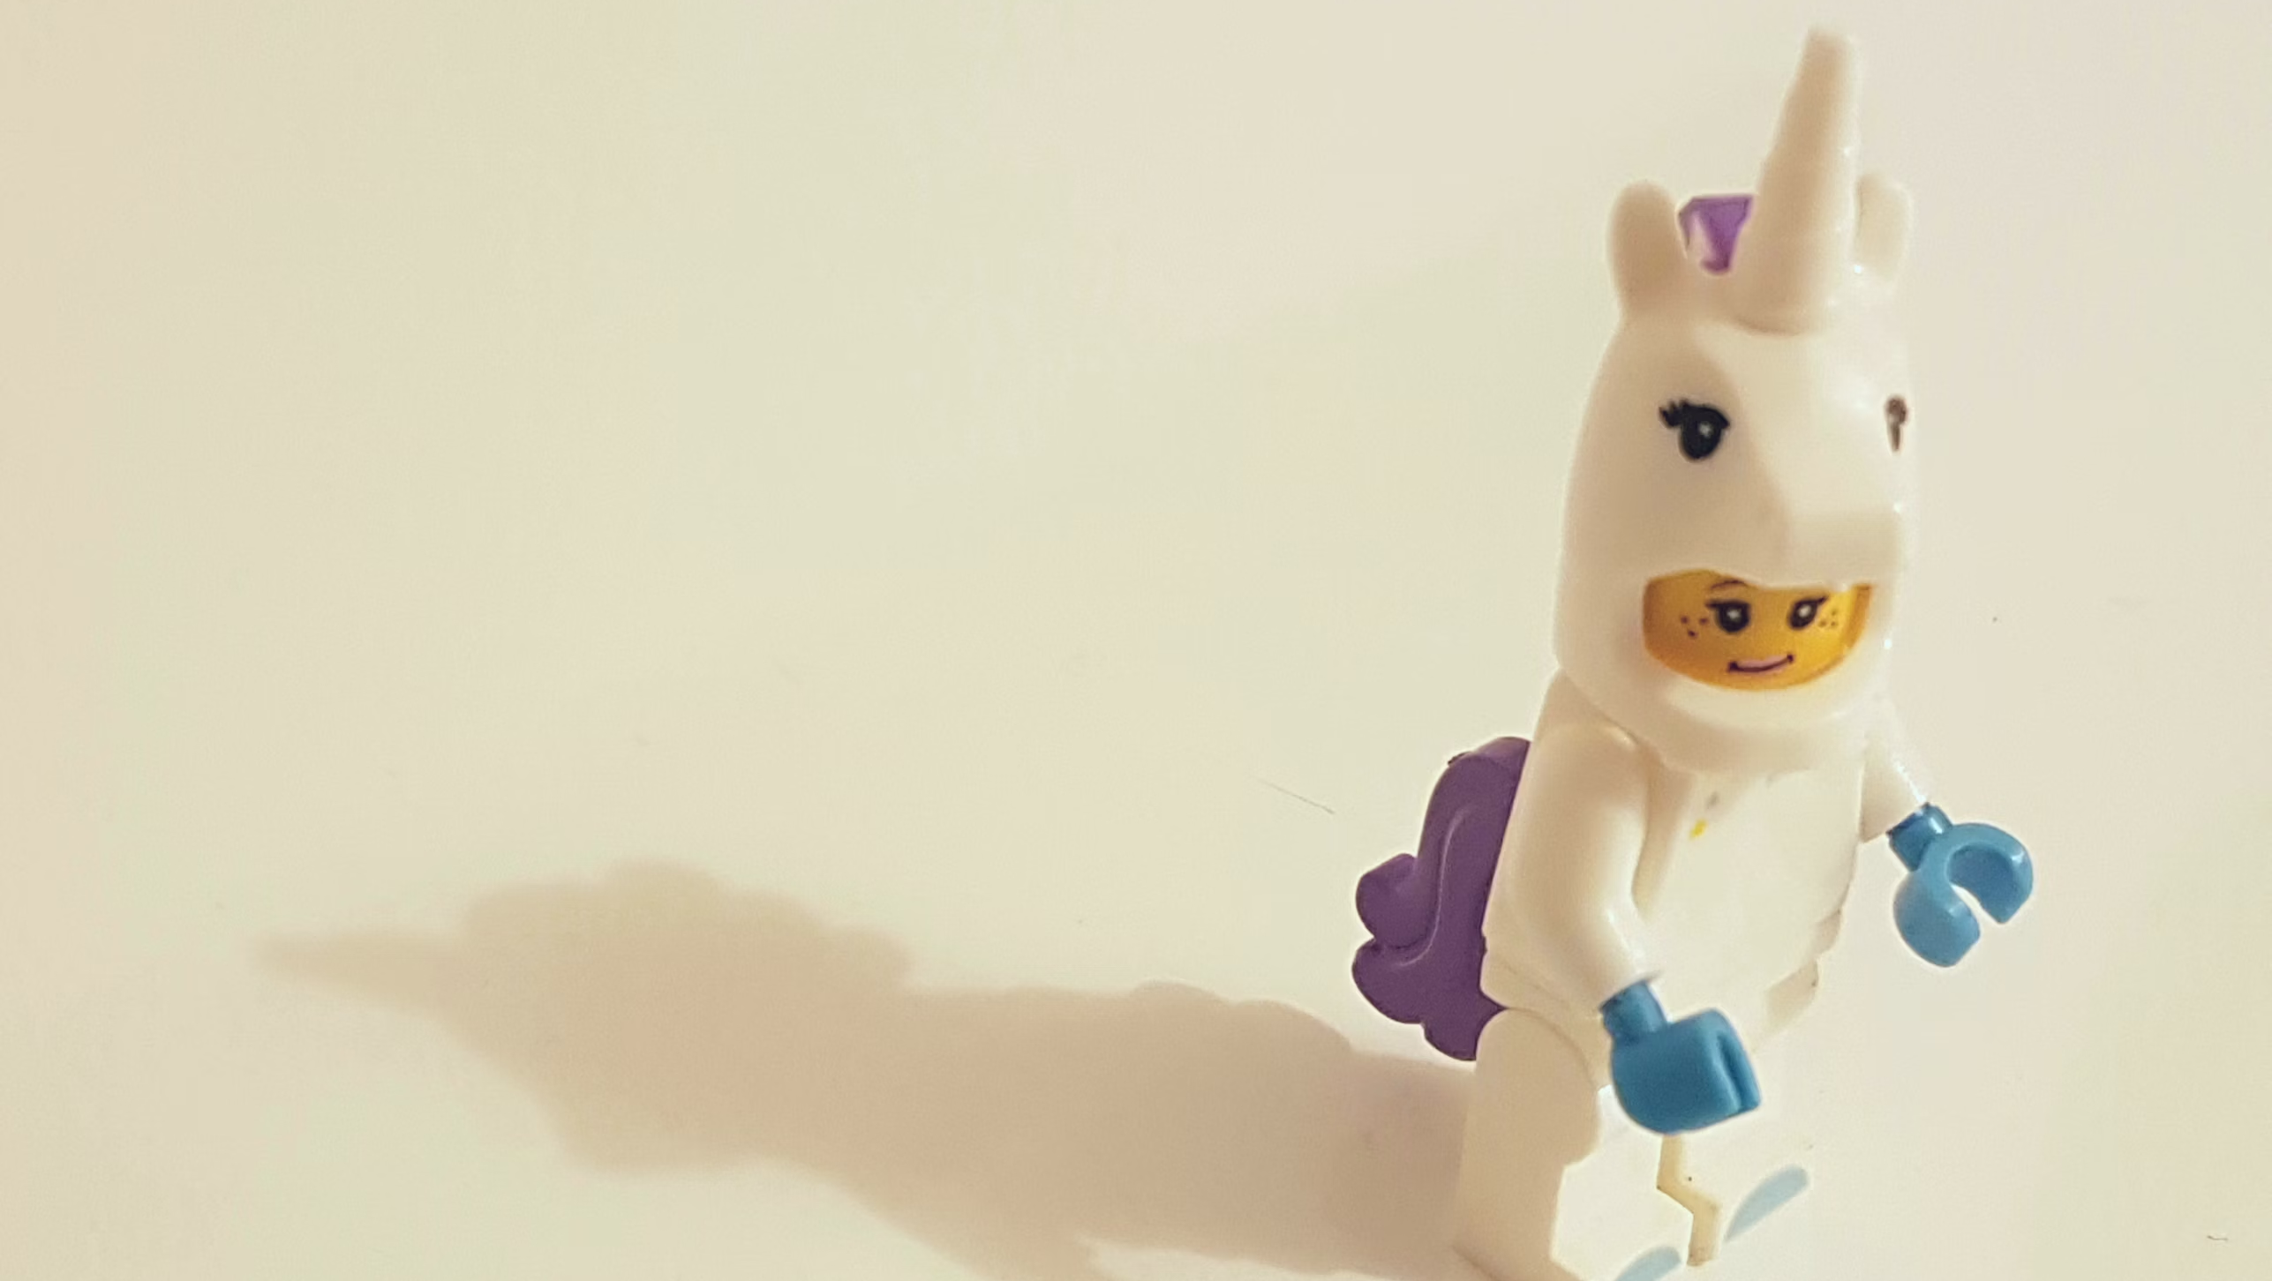
Dress up to the occasion
Notes:
You need to feel good

Slide 3

Practice
Notes:
Do you think the big artist don’t… Messi doesn’t practice ?

Slide 4

Less than 30 %
Notes:
Body language

Slide 5

Tips the important day:
Warm up.
Take care of your voice.
Select a monitor person.
Show up early, meet people.
Good openings.
Finish on a high.
Notes:
Adapt… Your resources, your presentation, think about your audience.

